Slide 1
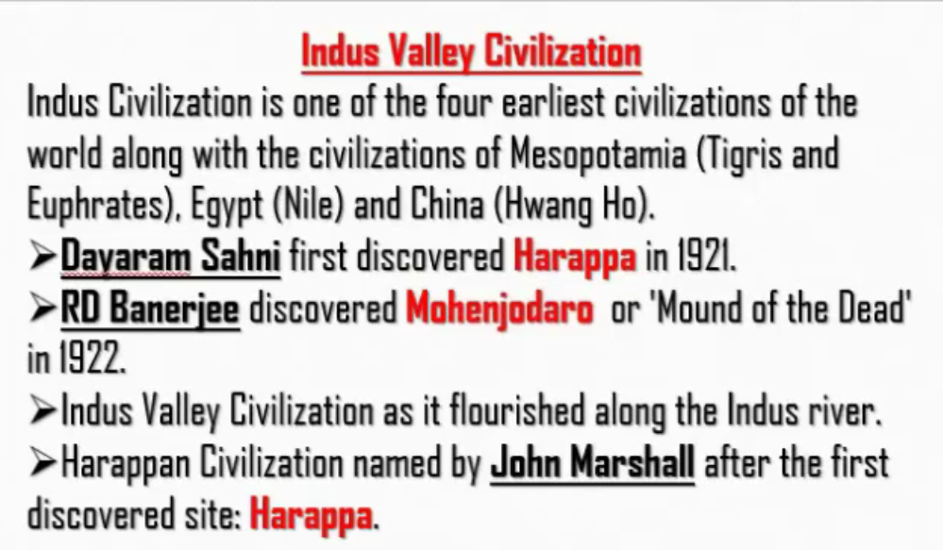
Indus Civilization – River
Mesopotamia Civilization – Tigris river and Euphrates river
Egypt Civilization – Nile river
China Civilization – Hwang Ho
Indus is known as “Sindhu” in Sanskrit and Hindi
Harappa and Mohenjodaro are two famous sites of Indus valley civilization.
Harappa site was discovered by Dayaram Sahni.
But the name to civilization was given by John Marshall

Slide 2
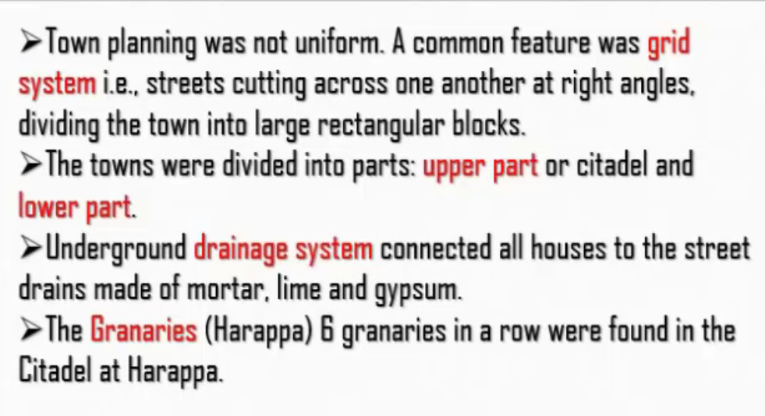
Grid System –
Underground of all houses got connected to one main street drain

Slide 3
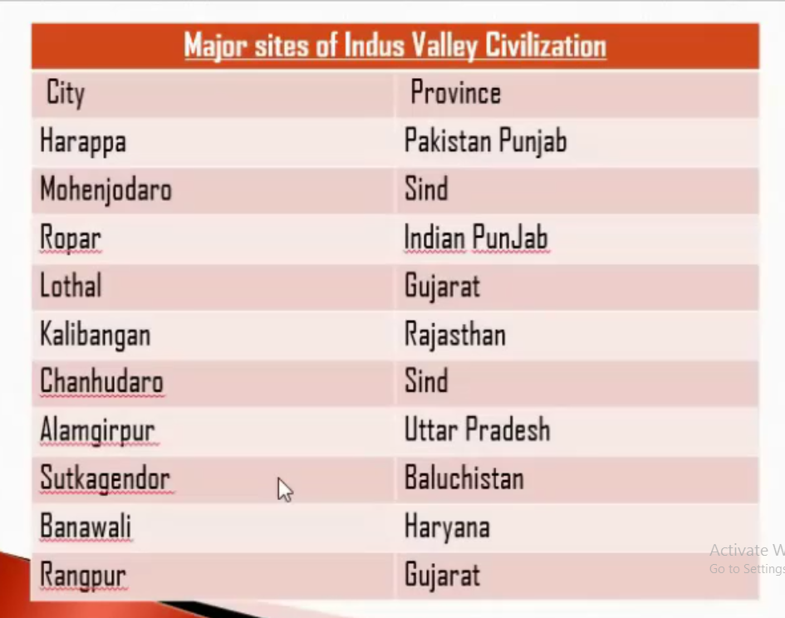

Slide 4
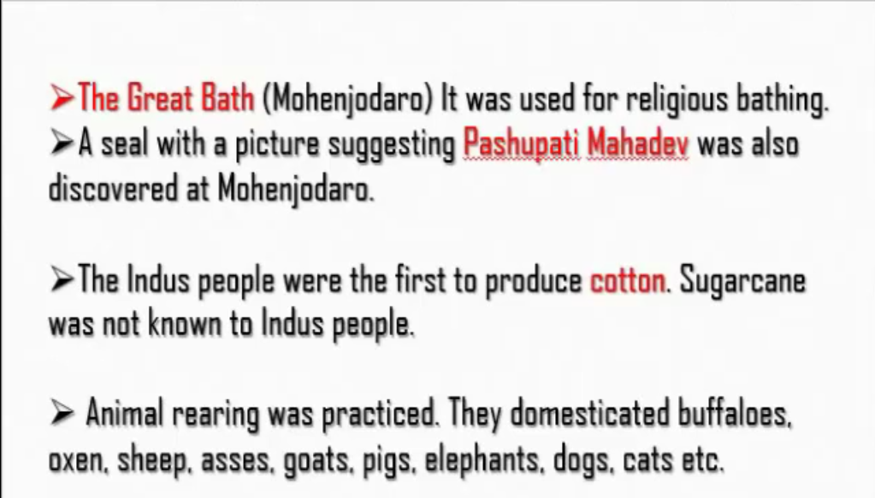
Indus river flowing in Mohenjodaro site was named as “Great Bath” where people made “Punya Snana” or “the religious bath”

Slide 5
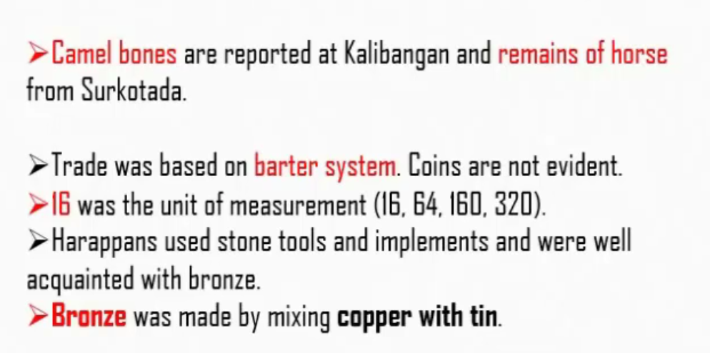
Kalibangan and Surkotada are sites of Indus Valley Civilization

Slide 6
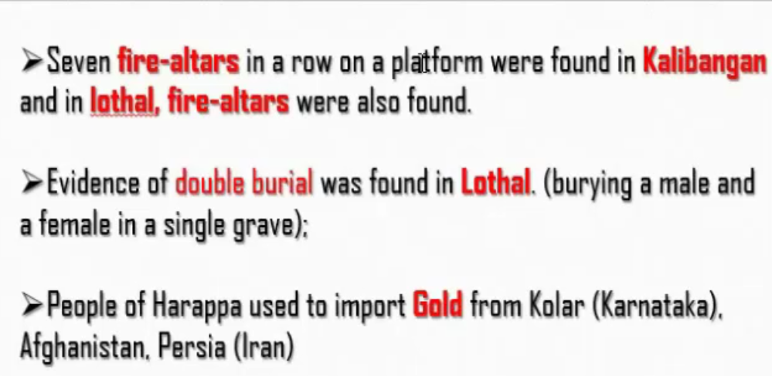
Fire Altars – Yaga Shale
Lothal – Site in Indus valley civilization
Double Burial – Husband and wife were buried in the same place or grave

Slide 7
